Slide 1

The WealthWise Financial Platform
George Fraher, Sam Buerck, Nathan O'Brien, Michael Paulsen, Carson Vanoverbeke

Slide 2

Introduction
WealthWise Financial Advising is a digital platform designed to be the all-in-one financial advising platform with all resources able to be accessed from one central site. The platform will:
Provide access to certified financial advisors
Offer a range of financial tools
Offer users access to the latest market news
Allow the user to manage personal wealth and investments efficiently

Slide 3
Problems With Current Systems
Inefficient Financial Management:
Many individuals lack access to personalized financial tools and professional advice, leading to poor decision-making.
01
Fragmented Resources: Users currently rely on multiple platforms for financial education, investment insights, and calculation tools, resulting in inefficiencies and inconsistencies.
02
Limited Accessibility: Traditional financial advisory services can be inaccessible due to cost, geographic barriers, and scheduling challenges.
03

Slide 4
Goals
Goal 1
Develop a centralized platform that provides personalized financial advisory services through an integrated booking system.
Goal 2
Offer comprehensive tools, such as financial calculators, market analysis, and educational resources, in a user-friendly interface.
Goal 3
Ensure the platform is scalable, secure, and accessible, catering to users with diverse financial needs.
Goal 4
Create features such as exclusive financial events and subscription models to enhance user engagement and satisfaction.

Slide 5
System Overview
User Management
Booking System
Secure registration, authentication, and subscription handling.
Financial Tools
Scheduling one-on-one consultations with financial advisors.
Educational Resources
A suite of calculators and analysis tools for budgeting, retirement planning, and investment tracking
Event Management
A repository of market news, financial trends, and expert insights.
Registration and tracking for webinars, workshops, and seminars.

Slide 6
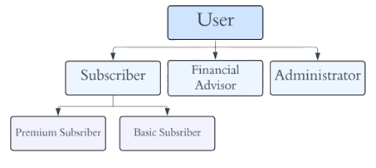
User Hierarchy of Roles
Users are assigned roles to give them access to parts of the site based on their duties.

Slide 7
Architecture Design and Design Pattern
Modular design for flexibility and scalability.
Integration of multiple systems:
- User management
- Financial tools
- Event scheduling
- Market news APIs.
- Secure backend ensuring data privacy.
Live Web Conferencing

Slide 8
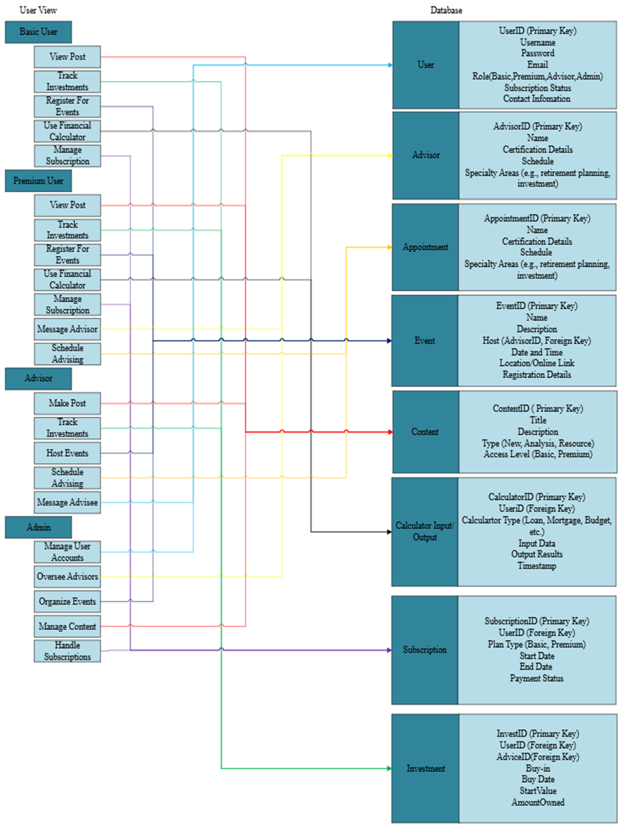
Database Diagram

Slide 9
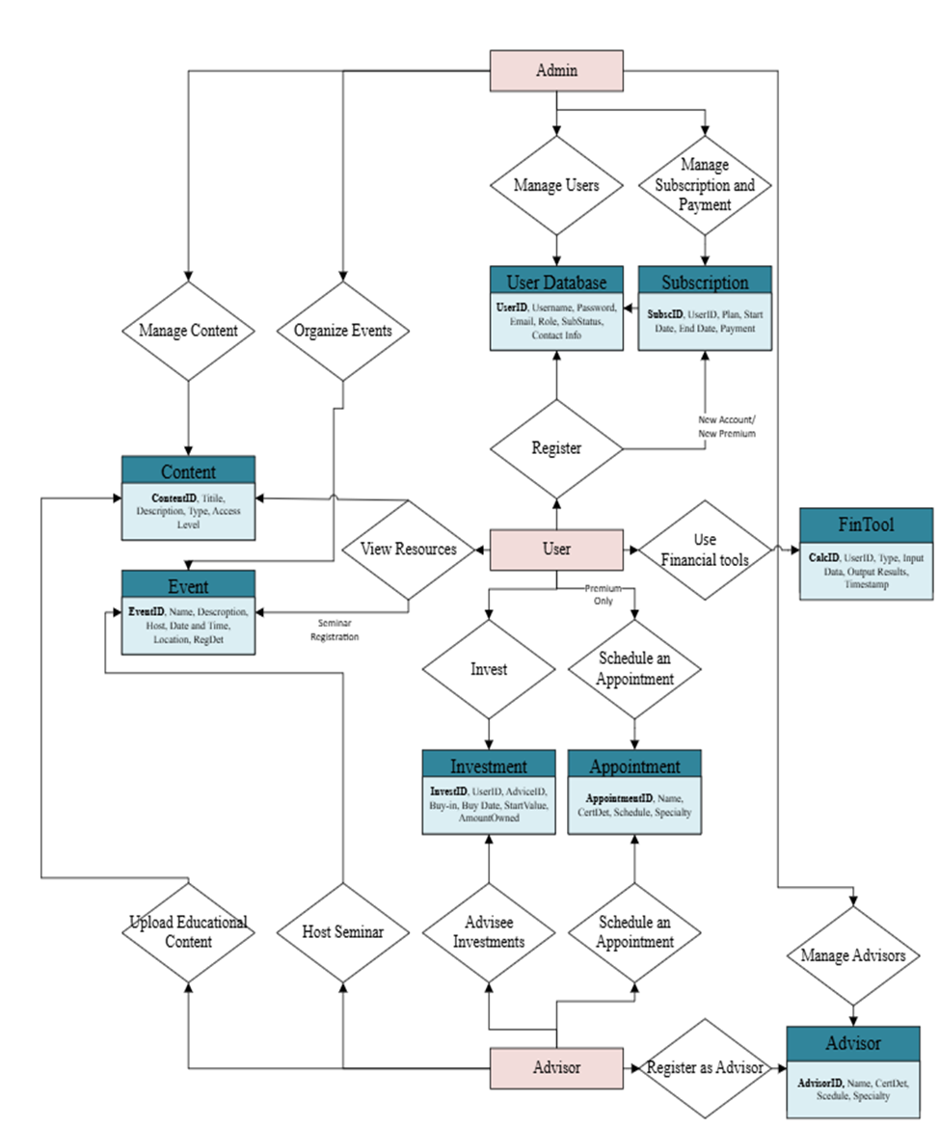
Level 1 Data Flow Diagram
Data Flow diagram shows examples of tasks each user can take and which database they will access when they do.

Slide 10
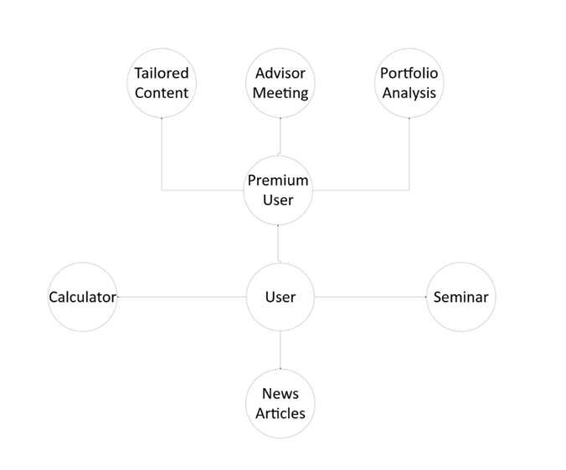
User Top Level Design

Slide 11






Technologies and Tools
Git
Github
Python
SQL
VScode
Streamlit

Slide 12

Challenges and Solutions
Challenges Related to the Project
Knowing what direction to take the platform (UI, Backend planning etc.)
Ensuring Security and Usability for users.
Knowing what tools to make this project tangible.
Our Challenges
Conflicting Schedules
Procrastination
Set Deadlines

Slide 13
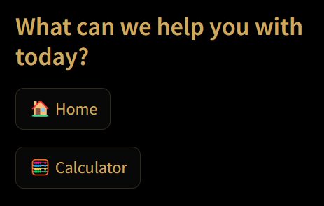
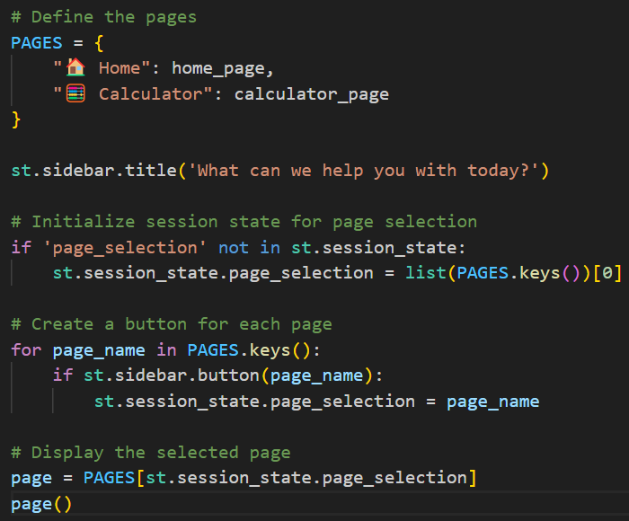
Prototype UI/UX
Simple user-interface with buttons used for navigation.
Easily scalable with the dictionary of pages

Slide 14
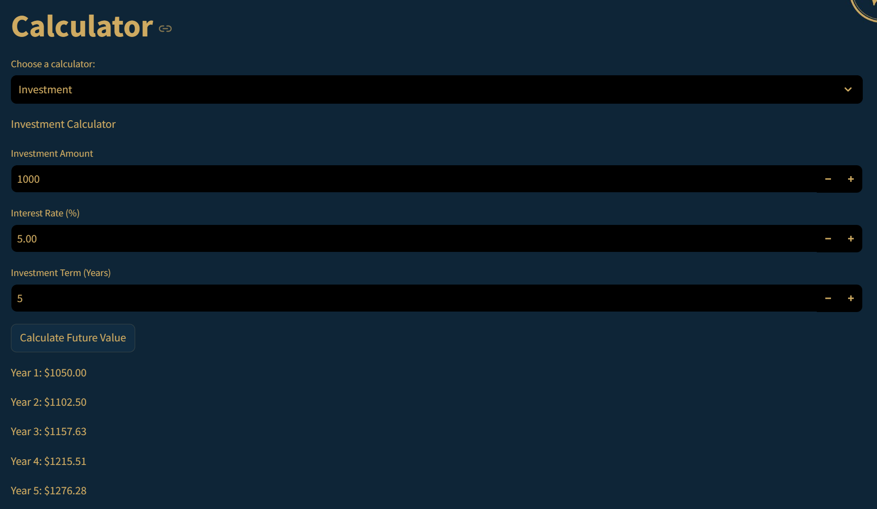
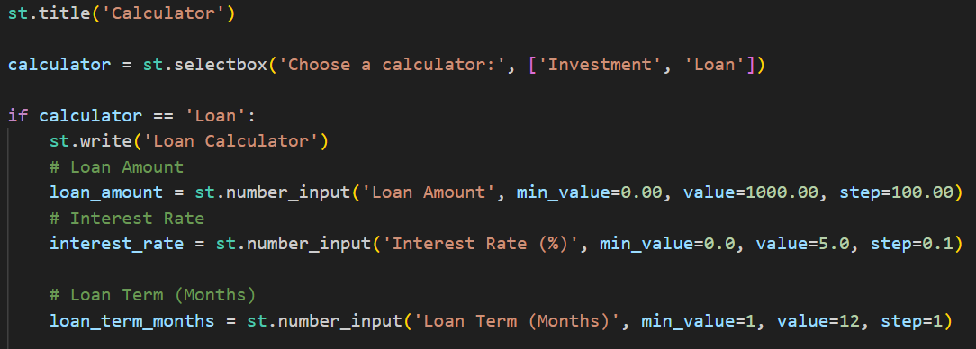
Prototype Calculator
Investment calculator that outputs each year’s investment growth to the user.

Slide 15

Conclusion
The WealthWise Financial Advising System is a robust, user-centric platform designed to tackle the challenges of financial management, accessibility, and personalization. By integrating secure systems, intuitive interfaces, and comprehensive tools, our solution aims to simplify financial decision-making for users of all levels.
The design emphasizes scalability, data security, and seamless user experience, ensuring the platform is adaptable to evolving needs. With a focus on innovation and inclusivity, WealthWise sets a strong foundation for transforming financial advising into a more accessible, efficient, and engaging process.
Thank you for your time and attention!

